Slide 1

Agile projects and Scrum

Slide 2

A bunch of lads got together in 2001
to sort out how projects should be managed.

Slide 3


Slide 4
AGILE MANIFESTO
“We are uncovering better ways of developing software by doing it and helping others do it. Through this work, we have come to value:
Individuals and interactions over processes and tools
Working software over comprehensive documentation
Customer collaboration over contract negotiation
Responding to change over following a plan
That is, while there is value in the items on the right, we value the items on the left more.”
Agile Manifesto Copyright 2001: Kent Beck, Mike Beedle, Arie van Bennekum, Alistair Cockburn, Ward Cunningham, Martin Fowler, James Grenning, Jim Highsmith, Andrew Hunt, Ron Jeffries, Jon Kern, Brian Marick, Robert C. Martin, Steve Mellor, Ken Schwaber, Jeff Sutherland, Dave Thomas.
This declaration may be freely copied in any form, but only in its entirety through this notice.

Slide 5
What was the problem?
The reality is that the technology market place is moving fast. Faster than most projects.
Many projects fail because they miss the market or go drastically over budget before anything of value delivered.
Notoriously difficult to plan.
Communication in teams is difficult to get right
Communication between customer and provider is difficult

Slide 6



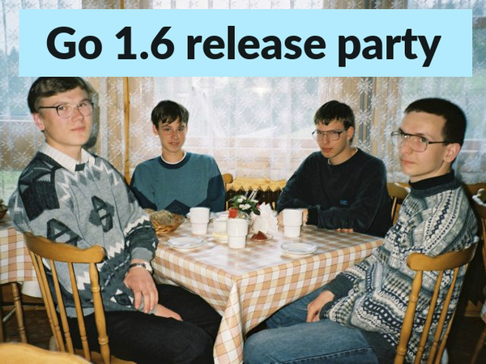
Waterfall projects don’t work well in the tech marketplace
Jan-Feb
Mar-Apr
May-Jun

Slide 7
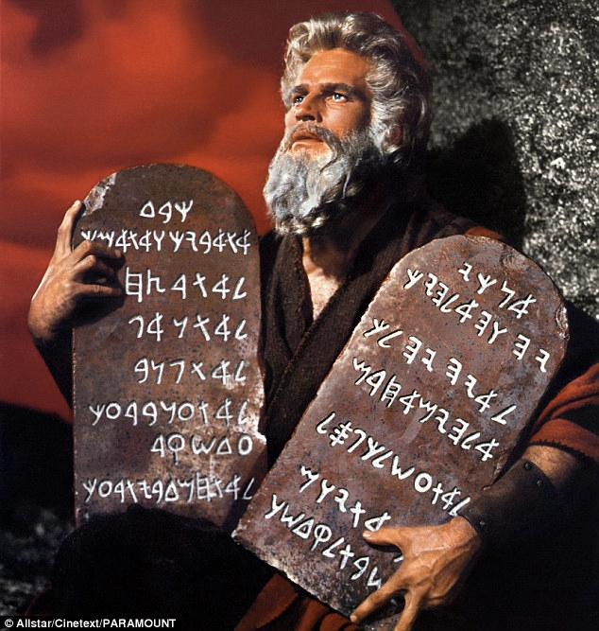
12 Agile Principles

Slide 8
1) Our highest priority is to satisfy the customer through early and continuous delivery of valuable software

Slide 9
2) Welcome changing requirements, even late in development. Agile processes harness change for the customer’s competitive advantage.

Slide 10
3) Deliver working software frequently, from a couple of weeks to a couple of months, with a preference to the shorter timescale.

Slide 11
4) Business people and developers must work together daily throughout the project.

Slide 12
5) Build projects around motivated individuals. Give them the environment and support they need, and trust them to get the job done.

Slide 13
6) The most efficient and effective method of conveying information to and within a development team is face-to-face conversation.

Slide 14
7) Working software is the primary measure of progress.

Slide 15
8) Agile processes promote sustainable development. The sponsors, developers, and users should be able to maintain a constant pace indefinitely.

Slide 16
9) Continuous attention to technical excellence and good design enhances agility.

Slide 17
10) Simplicity — the art of maximizing the amount of work not done — is essential.

Slide 18
11) The best architectures, requirements, and designs emerge from self-organizing teams.

Slide 19
12)At regular intervals, the team reflects on how to become more effective, then tunes and adjusts its behavior accordingly.

Slide 20
Forms of agile projects management
XP
SCRUM
LEAN/Kanban

Slide 21
XP
Extreme Programming
Coding is the core activity and best practices are EXTREMELY IMPORTANT.
Testing, testing and more testing. A bug in production is not a result of bad code but a result of not having defined the correct test.
Direct Communication between customer and programmer.
Refactoring is a critical part of the development process.

Slide 22
XP cont.
Planning: All members should be present. (both technical and non technical)
Customer is part of the team and should be available every day to answer questions. Preferably onsite
Any engineer can change any code. (collective ownership/code qa)
Sustainable pace
Pair programming
Regular code review and refactoring
Emphasis on simple designs
TDD
Small releases

Slide 23
Lean
Originated in the manufacturing industry (Toyota 1940)
Just in time delivery of products and services
Get rid of all excess.
stockpiles
workforce
Achieved by a central stack of tasks to be completed ordered by priority.

Slide 24
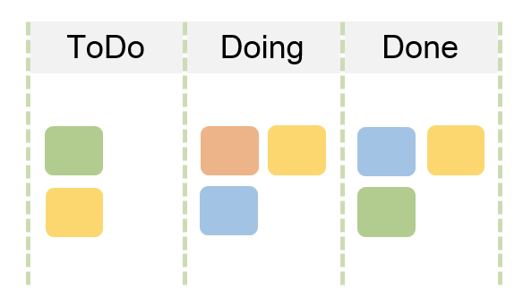
Lean - Kanban board
Kanban (Japanese for ‘visual signal’). A Kanban board is a tool used within factories that implement lean methadologies.

Slide 25


Lean - Kanban board
Rather than giving
tasks to individuals.

Slide 26
Lean - Kanban board
There is a Central todo /task queue for the entire team. The task with the highest priority is always at the top of the queue.
Team members take the task with the highest priority from the todo and start working on it. They move it to the doing column on the board. So others in the team can see that the task is in progress.
When completed they move it to the done column and take the next most high priority task from the queue.

Slide 27
Kanban
Kanban works really well for support and maintenance of software.

Slide 28
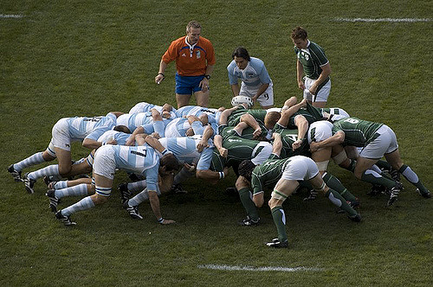
SCRUM
A team pushing in one direction to achieve a common goal.

Slide 29

Scrum - sprint
A central concept of scrum is the sprint.
A sprint is a short development iterations that delivers working code.
The development of a new product normally involves multiple sprints.

Slide 30


Scrum Sprint
Each sprint should be looking to deliver complete code. That can be demonstrated to the customer.
I.e. implement all layers of a feature (d.b. model, backend and frontend).
Instead of:
backend sprint 1
service sprint 2
frontend sprint 3

Slide 31

Sprints are short
Usually 1 - 6 weeks. With shorter sprints being favoured.
For larger projects 3 week sprint are common.

Slide 32
Scrum process
Requirements
Product backlog
Sprint backlog
Sprint retro
Sprint review
Release

Slide 33
Sprint lifecycle
Sprint planning
meeting
Retrospective
Daily standup &
Work on backlog
Sprint review,
Present achievements to stockholders
Sprint completed

Slide 34












SCRUM ROLES
Business
Stakeholder
Development
Team
Product Owner
Scrum Master
Other
Stakeholders

Slide 35
STAGE 1 Product Vision
What is are product?
Who will use it?
Product Owner
Business
Stakeholder

Slide 36
STAGE 2: Product Roadmap
Higher level view of the product requirements
A loose time frame
Create product backlog
Product Owner

Slide 37
STAGE 3: Release plan
A high level plan of feature releases
Agile projects normally release often
Product Owner

Slide 38
STAGE 4: Sprint planning
Plan what should be developed from the product backlog in the coming sprint.
Scrum Master
Development
Team
Product Owner

Slide 39
STAGE 5: Daily scrum
Max 15 minute daily meeting.
Also known as the standup.
Team members should answer
What you did yesterday.
What you will be working on tomorrow
Any reasons for not reaching sprint goals
Scrum Master
Development
Team

Slide 40
STAGE 6: Sprint review
Development team presents the working result of the sprint.
Other
Stakeholders
Business
Stakeholder
Scrum Master
Development
Team
Product Owner

Slide 41
STAGE 7: Sprint retrospective
How did the sprint process go:
GOOD
BAD
UGLY
Scrum Master
Development
Team
Product Owner

Slide 42
SCRUM Artefacts
Product vision statement
Product roadmap
Product backlog
Release plan
Sprint backlog
Increment

Slide 43
SCRUM ARTEFACTS
SCRUM ARTIFACTS
Scrum teams use three scrum artifacts, or deliverables, plus three other common agile practices to develop products in project management. As your team implements its plan, check for these articles and practices:
Product vision statement: An elevator pitch, or a quick summary, to communicate how your product supports the company’s or organization’s strategies. The vision statement must articulate the goals for the product. The product vision statement is a common agile practice but is not a scrum artifact.
Product roadmap: The product roadmap is a high-level view of the product requirements, with a loose time frame for when you will develop those requirements. The product roadmap is also a common agile practice but is not a scrum artifact.
Product backlog: The full list of what is in the scope for your project, ordered by priority. After you have your first requirement, you have a product backlog.
Release plan: A high-level timetable for the release of working software. The release plan is a common agile practice, although release planning is inherently part of scrum.
Sprint backlog: The goal, user stories, and tasks associated with the current sprint.

Slide 44
Definition of done
GIVEN
WHEN
THEN

